Slide 1



The Science of Menopause and Mental Wellbeing
Dr Katie Marwick
PhD, MRCPsych
Honorary Consultant Psychiatrist
Senior Clinical Research Fellow

Slide 2


Introduction
Woman – someone assigned female at birth.
Includes trans men and non-binary individuals.
Thurston 2025
Nature Reviews Psychology
Peer reviewed publication which is source of information or image.
First author Surname, Year and scientific Journal.
I have no conflicts of interest.

Slide 3
Menopause: a time of hormonal change
Estradiol
FSH
The two years either side of the final menstrual period are when most hormonal change occurs
Different people have different trajectories
On average the perimenopause lasts for 4 years,
but can be 7-10 years
-4
-2
0
2
4
Years around the final menstrual period
FSH: Follicle Stimulating Hormone
Modified from
Harlow 2012 Menopause
Katie Marwick
Alliance Scotland Webinar 2025
University of Edinburgh

Slide 4
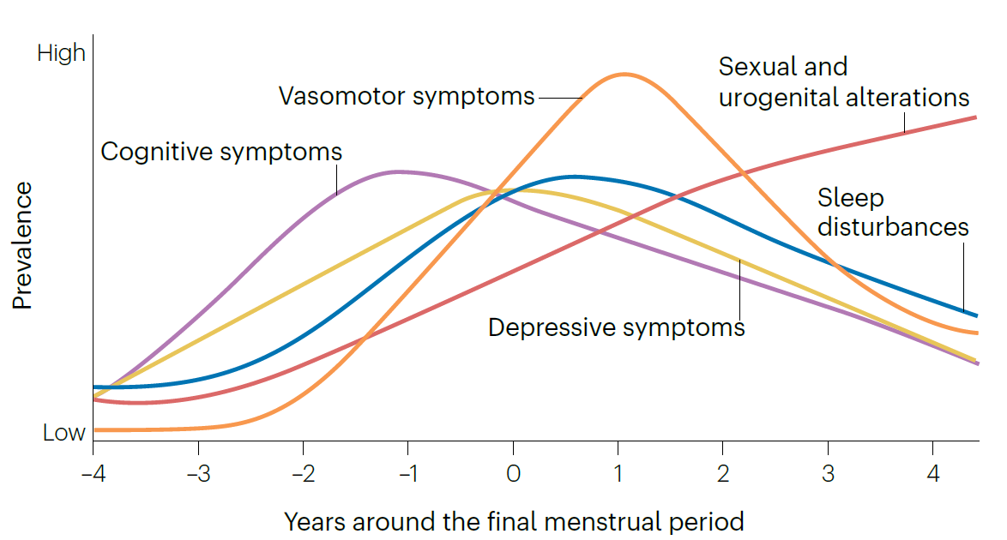

Menopause: a time of mental health challenge
Around 1 in 2 women in perimenopause experience
Low mood and anxiety
Cognitive symptoms
Sleep disturbance
Thurston 2025 Nature Reviews Psychology
Katie Marwick
Alliance Scotland Webinar 2025
University of Edinburgh

Slide 5
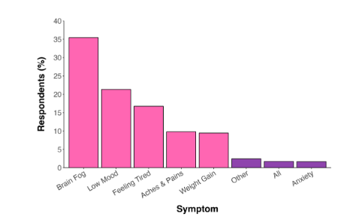
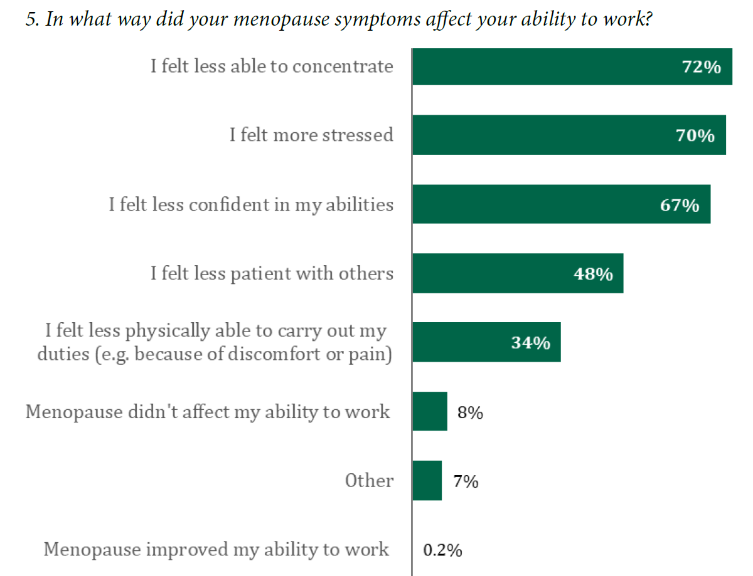
Menopause: mental health matters
7,513 UK women asked “What is the single most important symptom of menopause?”
2,161 UK women asked “In what way did menopause symptoms affect your ability to work?”
(hot flushes not given as an option)
House of Commons 2022
Menopause and the workplace survey results
Davies 2025 British Journal of Obstetrics and Gynaecology
Katie Marwick
Alliance Scotland Webinar 2025
University of Edinburgh

Slide 6
Menopause: low mood and anxiety
4 fold increase risk of clinically significant depressive symptoms
  No previous history: 10-30% of women
  Previous depression: 45-65% of women
3 fold increased risk of
depressive episode recurrence
in those with a history
1.3 fold increased risk of
first ever depressive episode
Is “perimenopausal depression” different to depression at other times?
“on/off” fluctuating low mood
Anxiety prominent
Cognitive problems prominent
Brown 2024 Lancet
Shitomi-Jones 2024 Nature Mental Health
Behrman and Crockett 2023 BJPsych Bulletin
Katie Marwick
Alliance Scotland Webinar 2025
University of Edinburgh

Slide 7



Mood changes during other reproductive transitions
Reproductive transition
Premenstrual
Postpartum
Perimenopause
Mood symptoms
Correlation
Correlation
Payne 2007 Journal of Affective Disorders
Gordon Smith 2024 Archives of Women’s Health
Katie Marwick
Alliance Scotland Webinar 2025
University of Edinburgh

Slide 8
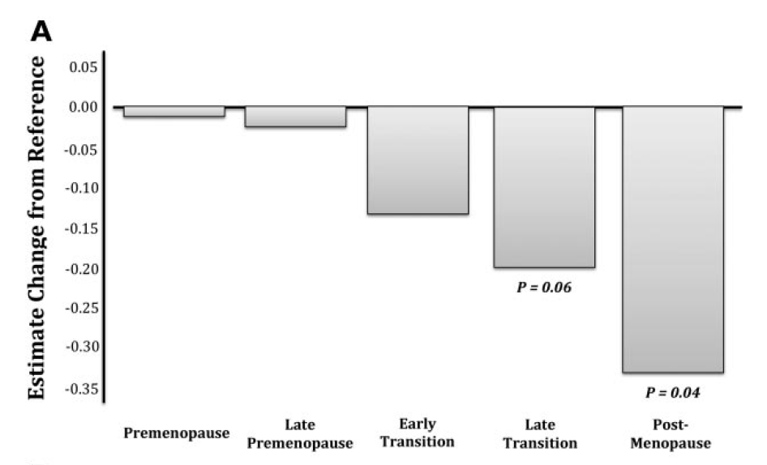
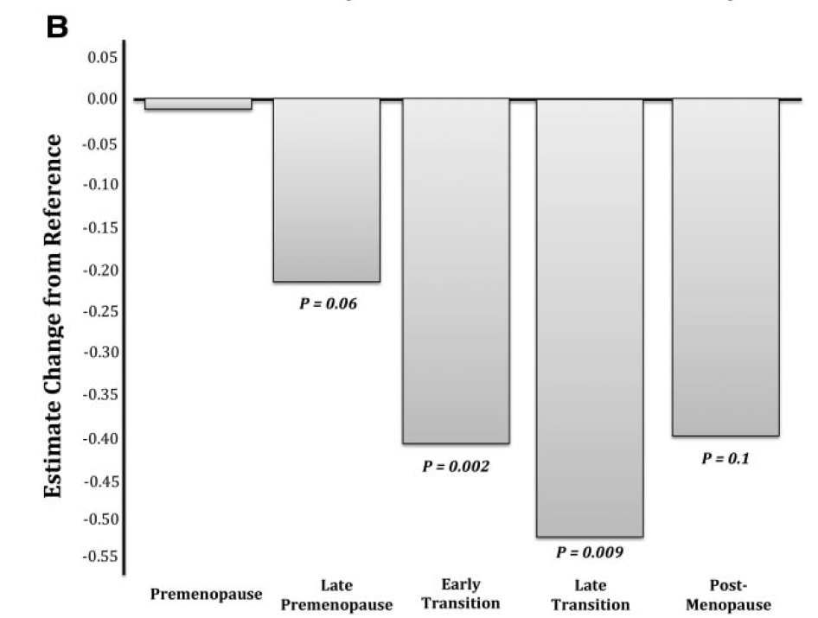
Menopause and objective cognition
Objective tests of cognition find verbal learning and memory are influenced by menopause stage
Processing speed may also be reduced
No effect of menopause on multiple other types of cognitive test
Immediate recall
Recall after 20 minutes
400 women in USA
followed over 14 years
Asked to remember a list of 16 words
½ a word less
Epperson 2014 J Clin Endocrinol Metab
Katie Marwick
Alliance Scotland Webinar 2025
University of Edinburgh

Slide 9
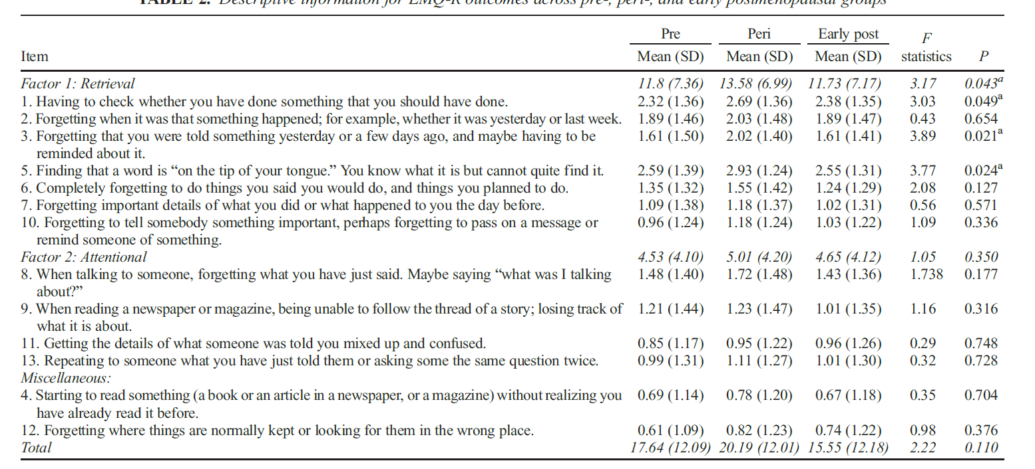
Menopause and subjective cognition: “brain fog”
417 women in Australia asked to rate frequency of “Everyday Memory” concerns
Retrieval is commonest problem in perimenopause
Postmenopause memory the same or better than premenopause
Zhu 2023 Menopause
Katie Marwick
Alliance Scotland Webinar 2025
University of Edinburgh

Slide 10
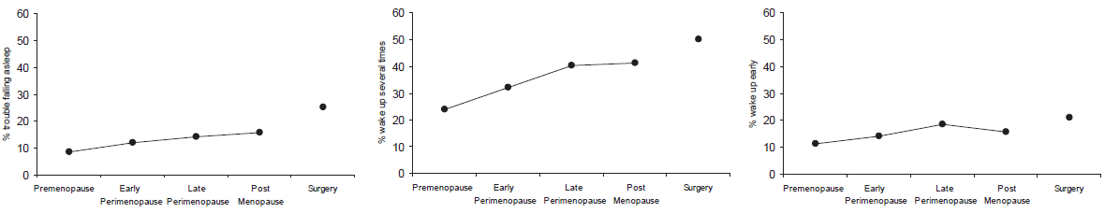
Menopause and sleep
4,045 women in USA followed over 7 years
Falling asleep
Staying asleep
Waking early
% with problem in last 2 weeks
Staying asleep shows biggest change with menopause stage
Both low oestrogen and high FSH associated with more difficulty staying asleep
Frequent hot flushes increase risk of sleep disturbance 5 fold
Trauma (childhood and adulthood) increases risk of hot flushes and of sleep disturbance
Kravitz 2008 Sleep
Thurston 2025 Nature Reviews Psychology
Katie Marwick
Alliance Scotland Webinar 2025
University of Edinburgh

Slide 11

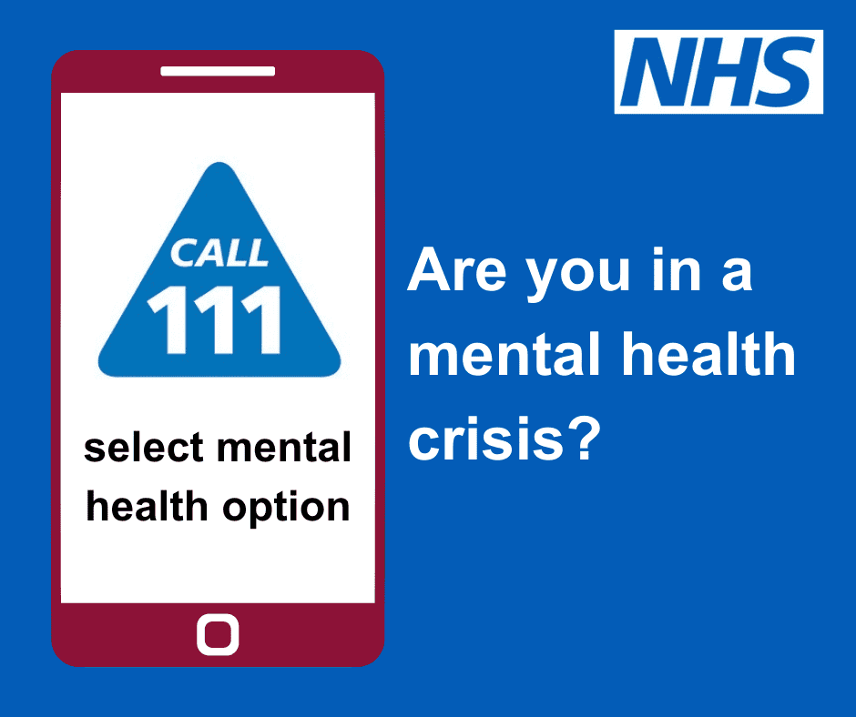
Menopause and severe mental illness
Severe mental illness includes bipolar disorder, schizophrenia and psychotic depression.
At least 3% of women live with these disorders.
Women with pre-existing severe mental illness are probably at increased risk of relapse around menopause (more work needed)
Perimenopause also a time of increased risk of new onset bipolar disorder (but still overall rare)
Watch out for
Suicidality
Feeling paranoid
Hearing voices
Very out of character behaviour
Get help from
GP
NHS 111
A&E
Shitomi-Jones 2024 Nature Mental Health
Katie Marwick
Alliance Scotland Webinar 2025
University of Edinburgh

Slide 12
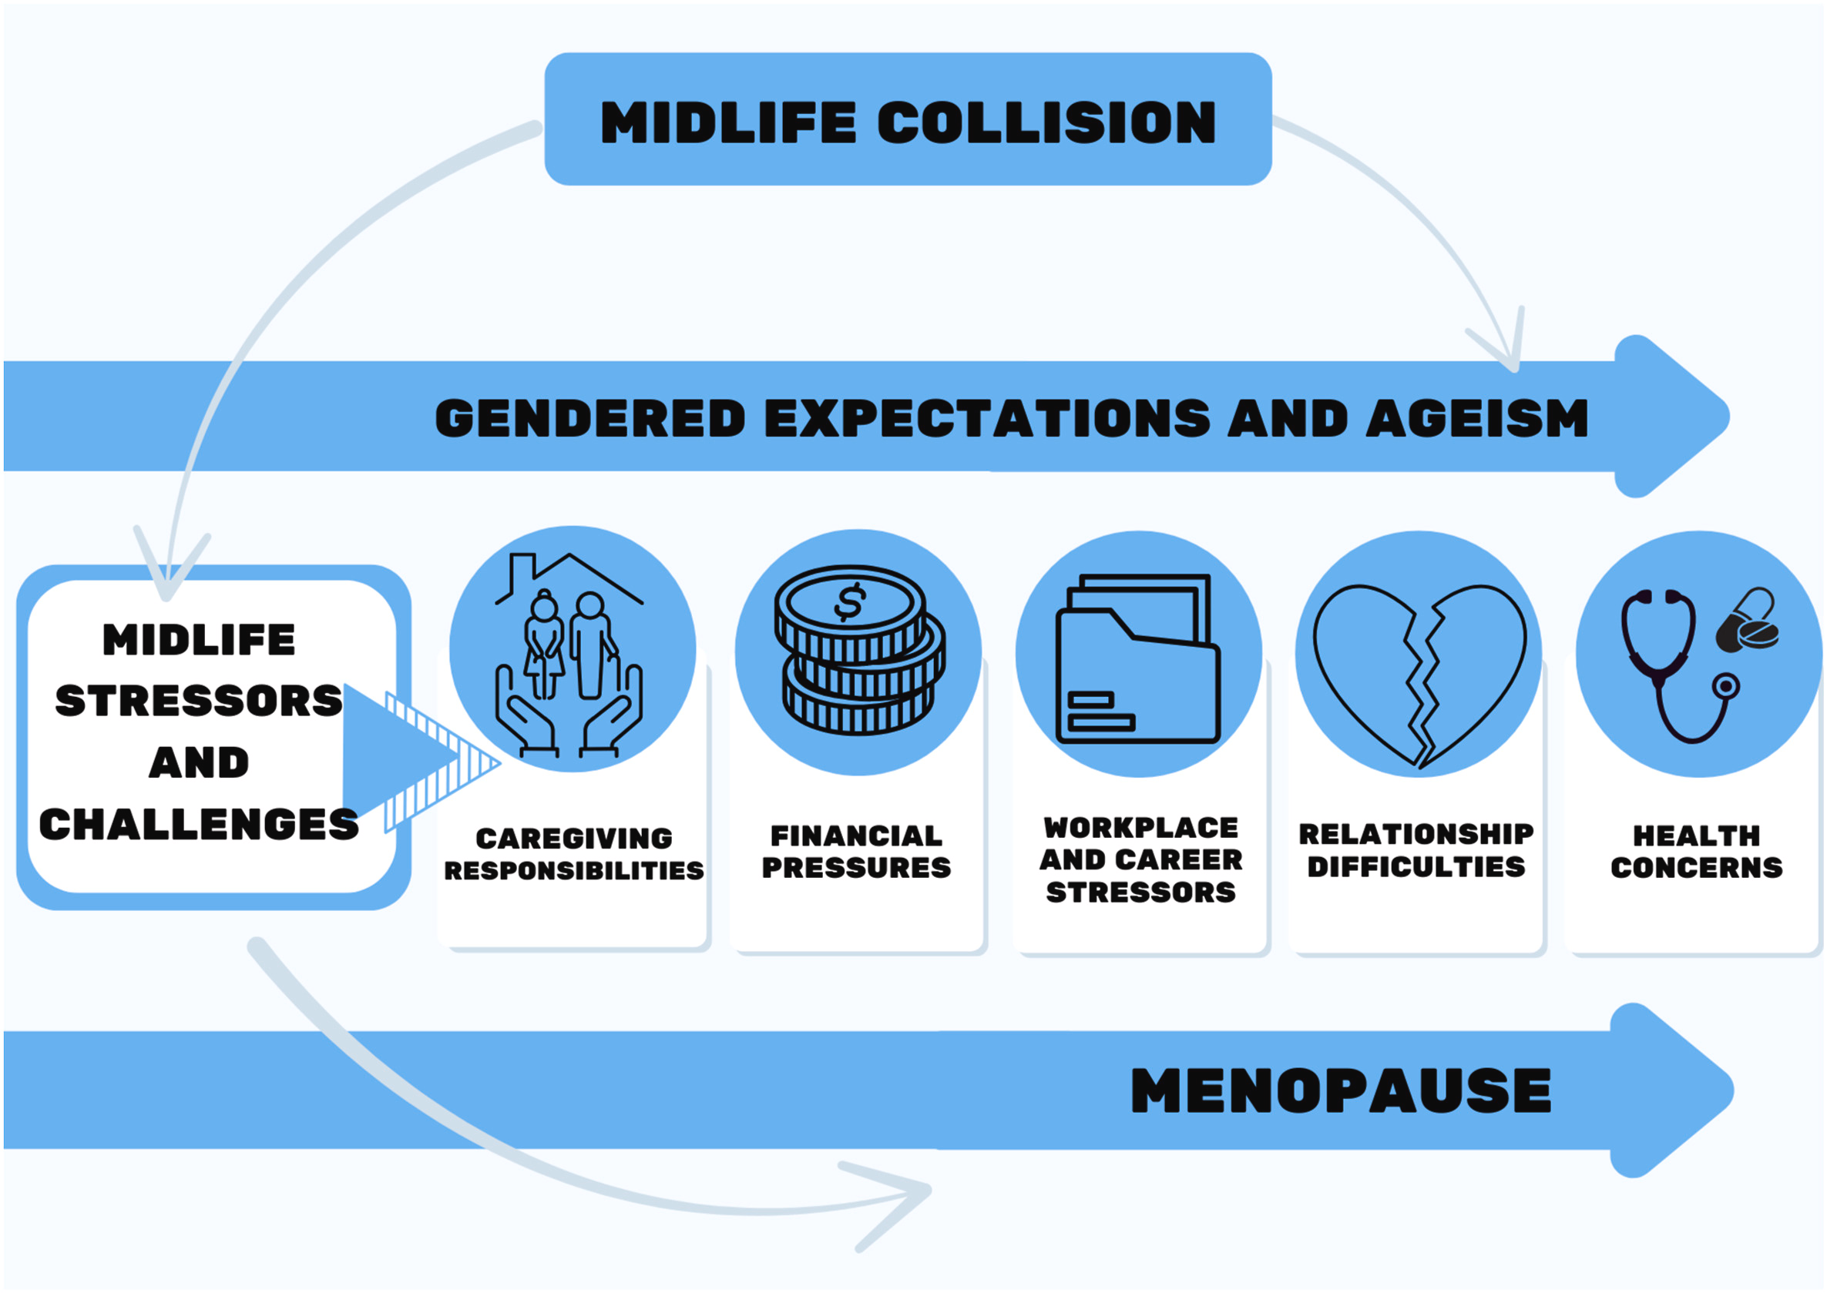
Menopause and mid-life challenges beyond biology
509 women in Australia asked about menopause and social pressures
“Hiding symptoms and balancing work, family and relationships”
Wood 2025 Social Science & Medicine
Katie Marwick
Alliance Scotland Webinar 2025
University of Edinburgh

Slide 13
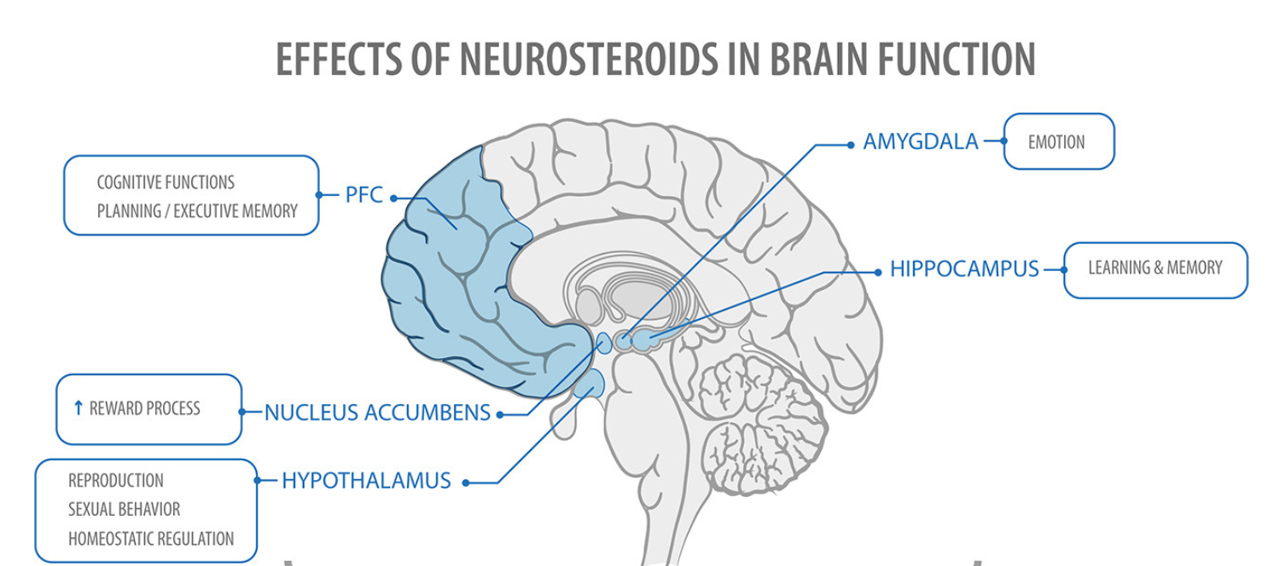
Reproductive hormones and the brain: multi-region
Sex hormone receptors are present in many brain regions involved in cognition, mood and behaviour
Del Rio 2018 Frontiers in Public Health
Katie Marwick
Alliance Scotland Webinar 2025
University of Edinburgh

Slide 14
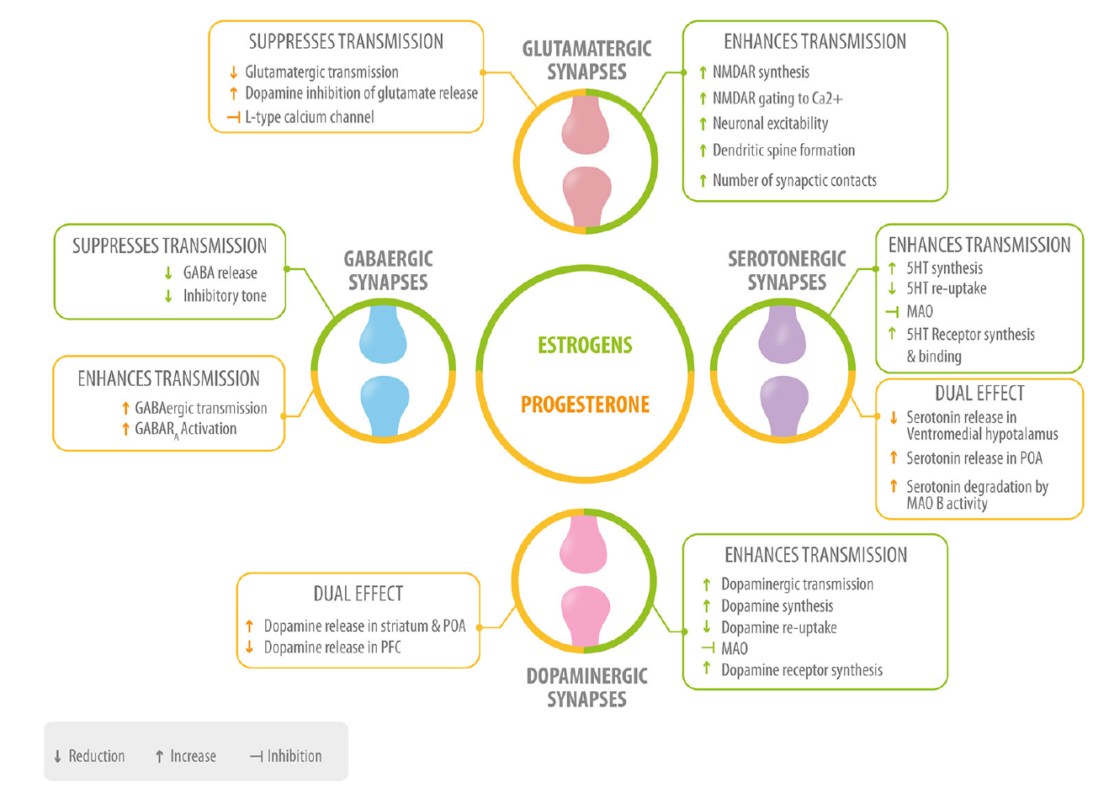
Reproductive hormones and the brain:
multiple neurotransmitters and systems
Sex hormones modulate multiple neurotransmitter systems relevant to mood and cognition
Sex hormones also regulate other systems which influence brain function
Inflammation
Metabolism
Effect of FSH on brain an emerging area
Del Rio 2018 Frontiers in Public Health
Katie Marwick
Alliance Scotland Webinar 2025
University of Edinburgh

Slide 15
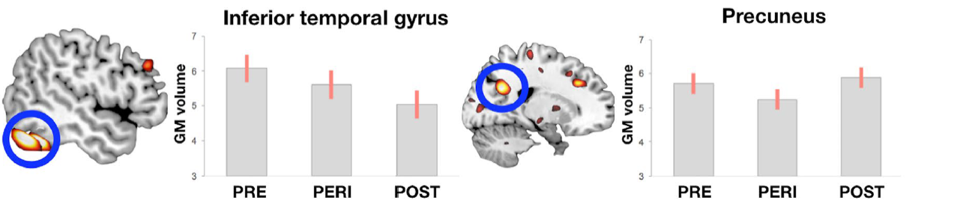
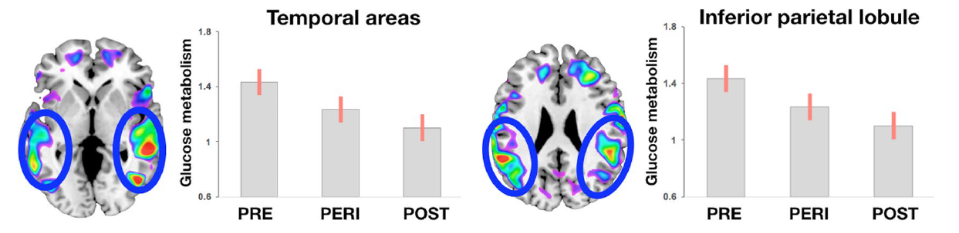
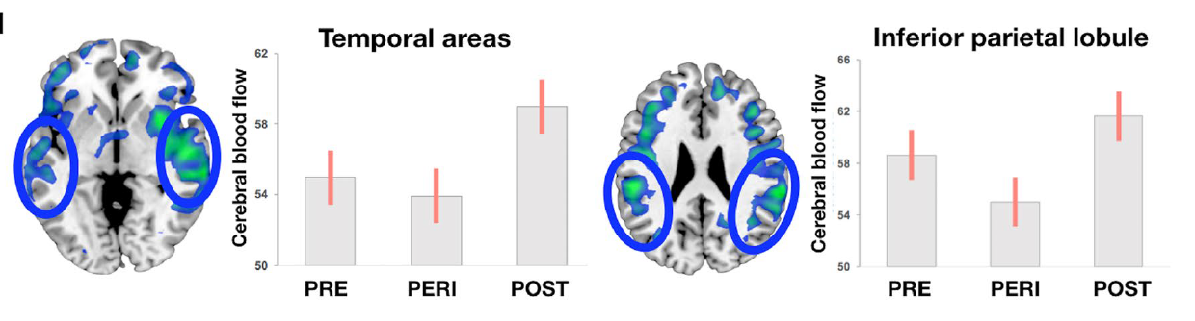
Menopause and the brain: a time of reorganisation
184 women in USA had a range of brain scans (cross-sectionally)
Grey matter volume
Changes in various brain regions and parameters during menopause
Glucose uptake
Pattern of pre vs peri vs post depends on region and parameter
Blood flow
Mosconi 2021 Scientific Reports
Katie Marwick
Alliance Scotland Webinar 2025
University of Edinburgh

Slide 16
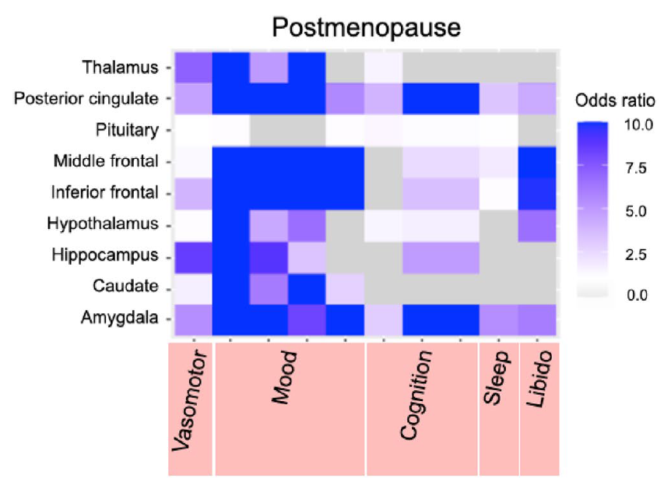
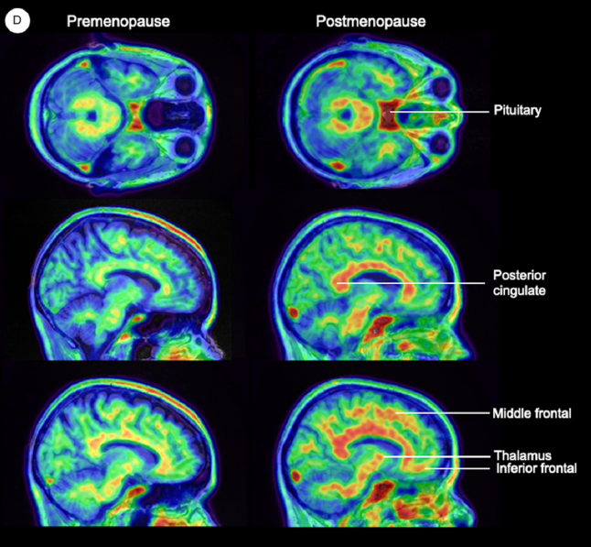
Menopause and the brain: oestrogen receptors increase
54 women
in USA
Post
Pre
Oestrogen receptor density in brain increases across menopause
Higher oestrogen receptor density in brain correlates with mood symptoms in postmenopausal women
Mosconi 2024 Scientific Reports
Katie Marwick
Alliance Scotland Webinar 2025
University of Edinburgh

Slide 17

Menopause and the brain: more work needed
Outstanding questions
What role might allopregnanolone and FSH have?
How important is timing of treatment initiation?
Would targeting body-wide processes influenced by sex hormones help mental health symptoms?
Could different subgroups of women benefit from different treatments?
Plus many more…
Katie Marwick
Alliance Scotland Webinar 2025
University of Edinburgh

Slide 18

The Science of Menopause and Mental Wellbeing Summary
The menopause is a time of risk for mental health symptoms
Social challenges intersect with biological changes
Menopause is associated with changes in brain structure and function
More work is needed to understand how brains update during the menopause
Katie Marwick
Alliance Scotland Webinar 2025
University of Edinburgh

