Slide 1
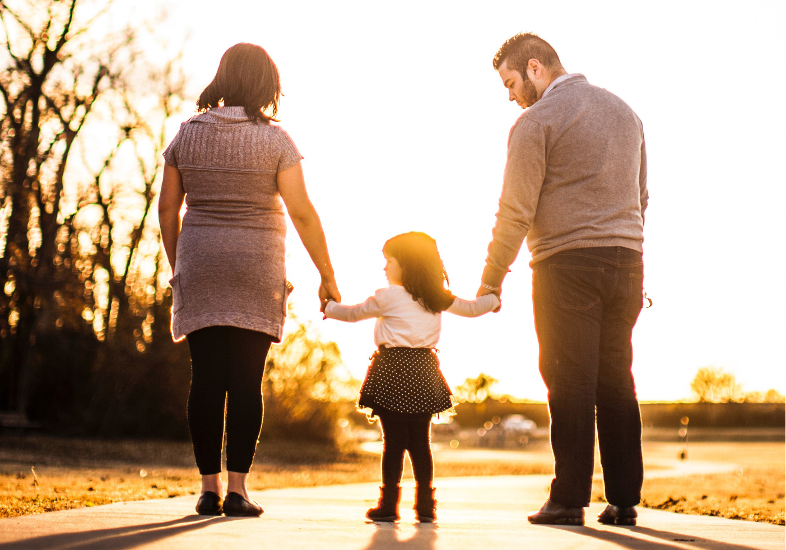
Lothian Strategic Development Framework April 2022
Notes:
Hello.
This presentation tells you about the Lothian Strategic Development Framework.
The Framework sets out our system view of the future for health and care services in Lothian, in light of the challenges we face including those brought about by the Covid-19 pandemic.
We are keen to hear what you think about our ideas for the future, and I will tell you how you can share your thoughts with us at the end of this presentation.

Slide 2
Contents
The Lothian Health & Care System
Our vision for the future
Where we are now
Assumptions
Principles, fixed points and proposals for change
The structure of the LSDF
Key messages
What next?
Notes:
Over the next few minutes, I’ll tell you about
The Lothian Health & Care System, and our vision for the future
Where we are now, and the challenges we face
What we think the future might look like
What we propose to do over the next five years, including what will stay the same, and what we think will change
How we are organising our plans in the LSDF
There’s a lot of information in these slides, so I’ll end with some key messages before sharing how you can tell us what you think.

Slide 3
Lothian Health & Care System
Lothian Health & Care System
The Lothian Health & Care System is made up of five organisations.
These organisations are responsible for planning, commissioning and delivery of health and care services in Lothian
East Lothian
Integration Joint Board
Edinburgh
Integration Joint Board
Midlothian
Integration Joint Board
NHS Lothian
West Lothian
Integration Joint Board
Notes:
The Lothian Health and Care System is made up of five organisations: Four “Integration Joint Boards” and NHS Lothian.
These organisations are responsible for planning and delivering health and care services in Lothian, to meet the needs of their communities. In some areas, the five organisations want to work together to plan high quality services that make the best use of our shared resources, and to ensure services are joined up across the Lothians for the people who use them.

Slide 4
System Vision
System Vision:
Citizens lead longer, healthier lives, with better outcomes from the care & treatment we provide
We connect health and social care services seamlessly, wrapping around the citizen in their home
We improve performance across our system, with better experiences for citizens and those who work for and with us
The organisations that make up the Lothian Health & Care System want to work together to achieve our system vision
Notes:
Together, the organisations that make up the Lothian Health & Care System want to ensure that:
Citizens can lead longer, healthier lives, with better outcomes from the care & treatment we provide
We connect health and social care services seamlessly, wrapping around the citizen in their home
We improve performance across our system, with better experiences for citizens, and those who work for and with us

Slide 5
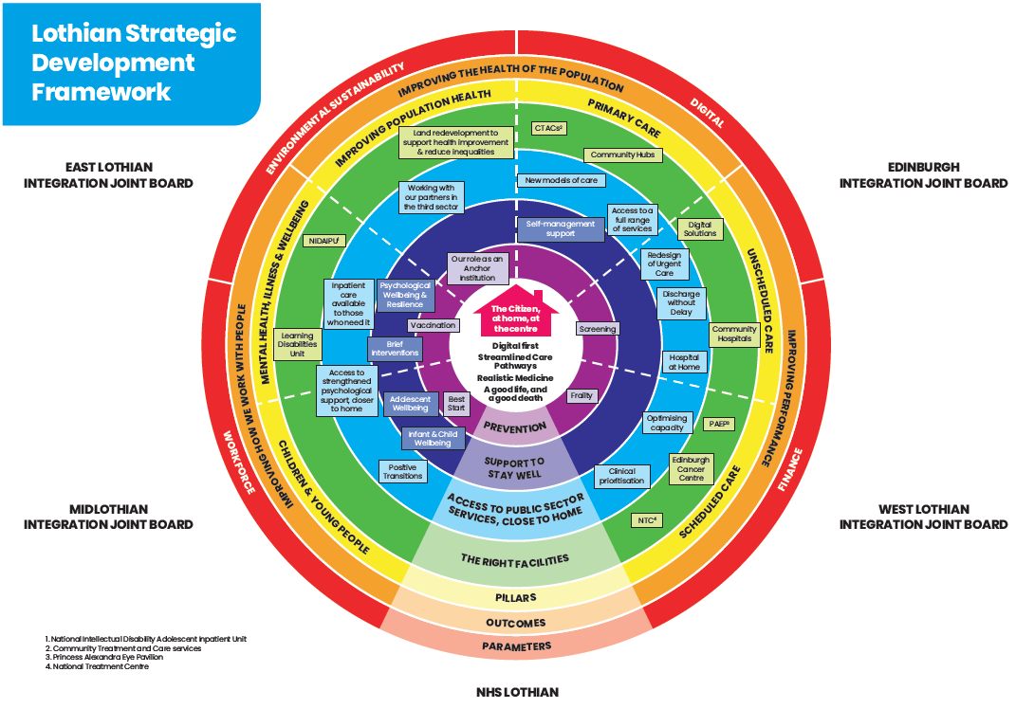
Lothian Strategic Development Framework
The Lothian Strategic Development Framework sets out what we want to happen over the next five years across the system, to help us to achieve our vision
Notes:
The LSDF describes what we are trying to achieve, our current situation, the changes we face and the direction of travel we propose to take. It also sets out what we want to happen across the system over the next five years to help us to achieve our vision.
I’ll come back to this picture later in the presentation.

Slide 6
Where are we now?
Performance
Change in access models
Impact on our workforce
Growth in inequalities
Unstable baseline
⬇
The Covid-19 pandemic has had a significant impact on health and care services.

☹
Notes:
To start with, I’d like to talk about where we are now.
The Covid-19 pandemic has had a significant impact on health and care services.
Our performance against key targets has declined
We have rapidly expanded different ways to access services including using video calling and the phone.
Our staff have been incredible. Many have worked long hours, in difficult circumstances and in different areas to help us manage Covid. It has been challenging and stressful, and many staff are exhausted.
We’ve seen a growth in inequalities, as people from our most deprived communities have been more likely to fall ill with and die as a result of Covid-19. We have also seen unemployment and universal credit claims rise. One in four children are living in poverty.
And as the pandemic situation continues to change with the rise of new variants, we cannot be exactly sure of what the future might look like in terms of the number of people who are unwell with Covid, and need to be looked after within our services.
I’d like to talk about some of these things in a bit more detail.

Slide 7
Scheduled inpatient activity
This chart shows the number of patients admitted to hospital on a planned basis from March 2018 – December 2021.
We haven’t been able to admit as many people to our hospitals for scheduled treatment such as operations because we need to make sure we have space to care for people with Covid, and keep everyone safe. This means that some people are waiting longer
Planned inpatient admissions to hospital, March 2018 - December 2021
Source: NHS Lothian Hospital Activity Trends Dashboard
Notes:
This chart shows planned inpatient admissions to hospital from March 2018 to December 2021.
We haven’t been able to bring as many people into our hospitals for scheduled treatment since the start of the pandemic. This is because we need to make sure we have space to care for people with Covid within our hospital wards and critical care units, and the space to keep everyone safe through social distancing. We have continued to maintain social distancing in many areas to protect the vulnerable people who need to access our services.
This means that some people are waiting longer to come into hospital for treatment, and we have been working to make sure that those with the greatest need receive treatment first.

Slide 8
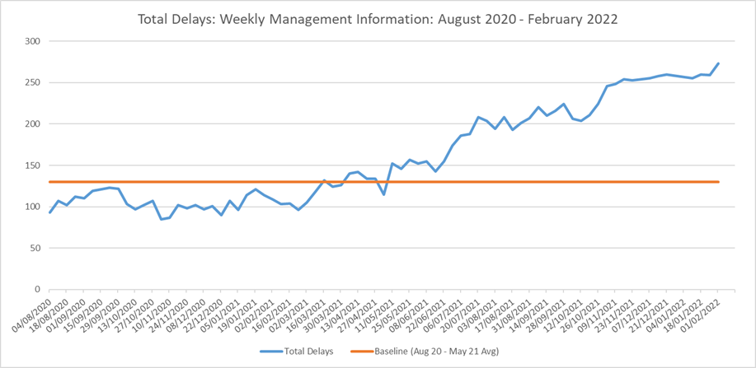
Delayed Discharges
The number of patients who are unable to leave hospital when they no longer need hospital care is increasing.
This chart shows the number of delays each week in Edinburgh since October 2021.
The chart below shows the number of delays each week in Edinburgh since 5 October 2021.
The baseline shows their average position between August 2020 and May 2021, where delays were at their lowest.
Source: Weekly Delayed Discharge Management Information
Notes:
The number of people who are unable to leave hospital when they no longer need hospital care has been increasing. This chart shows the number of delays each week in Edinburgh since October 2021. These delays can happen when the care people need at home or in their community is not available, or is in short supply. We are working together as a system to tackle this challenge.

Slide 9
Underlying Challenges
Population change
Condition of our estate
Technology
Climate change
Resource Availability




The impacts of the Covid-19 pandemic have added to the challenges we were already facing as a health and care system.


✓

Notes:
The impacts of the Covid-19 pandemic have added to the challenges we were already facing as a health and care system.
The population of Lothian is growing and has been ageing. This has created increasing demand for health and care services.
We need to look after our buildings and equipment, to make sure they are fit for purpose, and suitable to deliver effective services.
Technologies to support healthcare are advancing rapidly, and we need to invest in these technologies to support people to manage their own health and access services in a convenient, efficient and effective way when needed.
The affects of Climate change mean that we need to act to address the climate emergency. We want to be a lead organisation in sustainable healthcare by taking action to minimise our environmental impact and protect the natural environment.
Finally, our resources are limited and under pressure. This includes money but also includes our resources in terms of people working within the system.

Slide 10
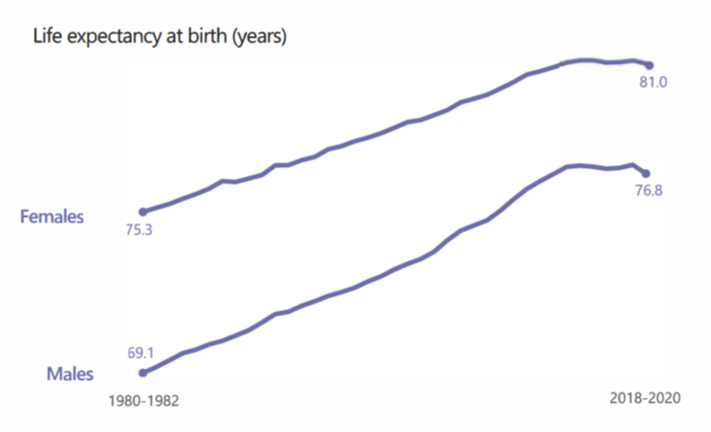
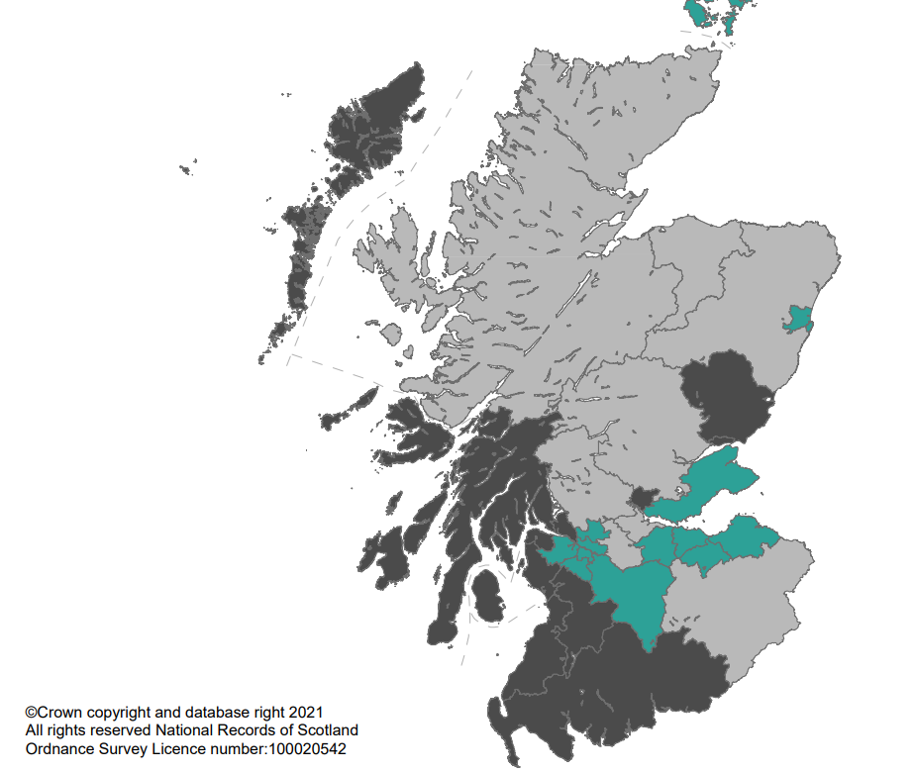
Population Change
Life Expectancy in Scotland, 2018-2020, nrsscotland.gov.uk
Mid-year population estimate, 2020, nrsscotland.gov.uk
Lothian’s population is growing, & in general people are living longer than they would have one hundred years ago. This means that demand for health services is increasing. We need to use resources carefully to met the needs of our population.
Notes:
After the second world war, life expectancy in Scotland grew year-on-year until around 2013. Since then, we’ve seen a small downturn in life expectancy, or a “levelling off”.
In general, this means that you are likely to live longer now than you were in the past. This is a testament to improvements in general population health and innovation in medicine and healthcare – but this has also created increased demand for health and care services, as people are likely to need them more in their later years.
On top of longer life expectancy, the population of Lothian and other areas, mostly around the Central Belt, is growing. This means that we need to use our resources carefully to meet the needs of our population.

Slide 11
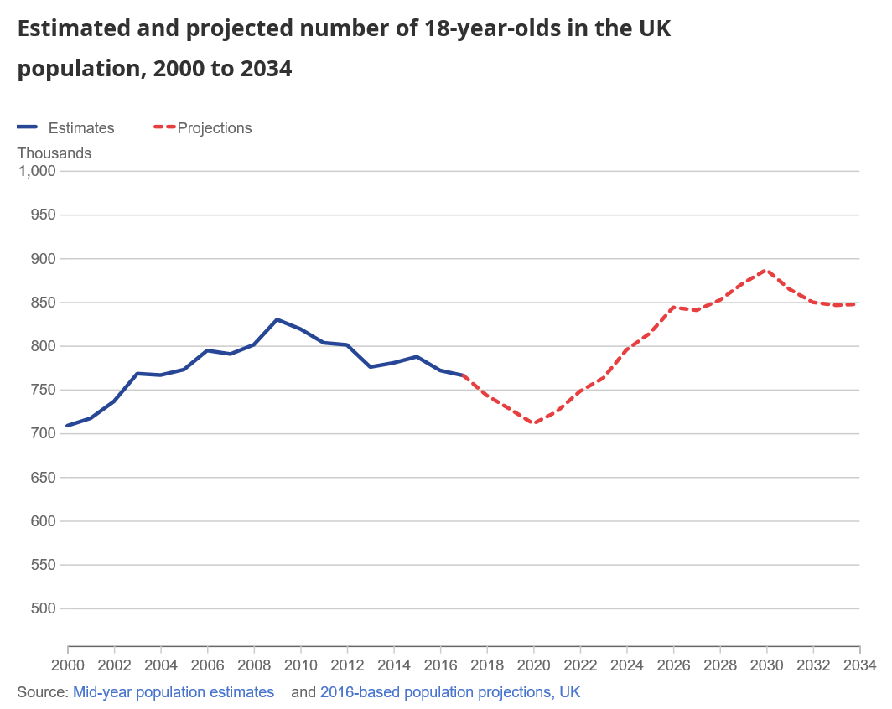
Workforce Supply and Demand
Within our workforce, there are a number of areas where workforce supply does not meet demand.
We cannot simply train more clinicians, as there are not enough young people in the population
This means that we will need to change our models of care, to make the best use of the resources we have available
Source: Office of National Statistics https://www.ons.gov.uk/peoplepopulationandcommunity/populationandmigration/populationprojections/articles/being18in2018/2018-09-13
Notes:
Within our workforce, there are a number of areas where workforce supply does not meet demand.
For example, there may be more people retiring from a staff group than are in training.
We cannot simply train more clinicians, as there are not enough young people in the population for us to train the volume of people we would need to continue to work in the same way. This means that we will need to change our models of care, to make the best use of the resources we have available.

Slide 12
Assumptions
We will honour legally committed investment to date
We will test fully approved investment (not yet legally committed) against our principles before legally committing
We accept that there will be significant financial constraints
We will start with large waiting lists and work through these according to clinical prioritisation
Workforce availability will be a key consideration, and all models will need to reflect this
The pandemic has and will continue to change our models of care. How significantly is uncertain
There will be a requirement for redesign capacity to support change
There will be an evolving context and narrative
While we cannot be certain what the future holds, we have made some broad assumptions about what the next five years might look like
Notes:
While we cannot be certain what the future holds, we have made some broad assumptions about what the next five years might look like
In particular we need to:
Accept that there will be significant financial constraints, and that we may need to make difficult choices about how best to use available funding
Acknowledge that we will start with large waiting lists, and will need to prioritise to ensure that those with the greatest need receive treatment first
Think carefully about workforce availability when we plan future models of care
Accept that the pandemic will continue to change our models of care, and that we need to be prepared for that

Slide 13
Principles
All cases and actions need to be clear on the question they seek to answer
All cases and actions need to be able to demonstrate that they advance the organisational strategy
All facilities will be flexible and multi-use
We will work to reduce “on-site” attendances wherever we can
We will separate emergency and elective activity where possible and maximise the use of “single-day” pathways
We will align actions and facilities with our public and third-sector partners
Non-clinical space will be minimised
Our actions and facilities will align with the Climate Change (Scotland) Act which outlines a requirement for the public sector to achieve net-zero by 2045 at the latest.
We have agreed a set of Principles for the future, that we want to apply across the system and when we design new services and models of care
Notes:
We have agreed a set of Principles for the future, that we want to apply across the system, and when we design new services and models of care
In future, we want any facility that we build to be flexible, so that it can be used for many different purposes
Wherever we can, we will work to reduce the number of times we ask people to come to our buildings and sites to access services
We will try to separate emergency and elective activity and maximise single day pathways so that people are not coming to hospital unless they need to, and are not staying in hospital longer than necessary
We will seek to align our work and our facilities with our partners in the public and the third sector to make access simpler and easier for those who use our services
We will seek to minimise non-clinical space on our sites, so that we are maximising our available space for clinical care
We will seek to ensure that our actions support the ambition to achieve net-zero carbon emissions

Slide 14
Fixed Points
We will work to support citizens to stay well at home
The Royal Edinburgh Hospital
a specialist mental health facility
specialist learning disability and rehabilitation services
The Royal Infirmary of Edinburgh
Unscheduled care centre
Major Trauma, Neurosciences & Children’s
New Eye Pavilion
Notes:
We have agreed a series of fixed points, which we expect to remain consistent over the next five years.
The most important of these is the citizens home. We will work to support citizens to stay well at home, and to access services at home when we can.
We intend to retain our four hospital campus sites, in line with the Lothian Hospitals Plan.

Slide 15
Fixed Points (2)
St John’s Hospital
District general hospital for West Lothian
New National Treatment Centre
Western General Hospital
New Edinburgh Cancer Centre
West Lothian Community Hospital
A new model of care; a new building
Midlothian and East Lothian Community Hospitals
Notes:
We will maintain community inpatient facilities in West Lothian, Midlothian and East Lothian, and will look to maximise what we can provide on these sites.

Slide 16
Proposals for Change
An emphasis on prevention & self management
New ways of accessing services
Bringing public services together in flexible community hubs
A changing model for primary care
Stronger communications and links across our system
More services for people with mental health needs or learning disabilities in the community
Implement systems to schedule urgent care
Improve efficiency and productivity of scheduled care services
Notes:
We intend to take forward a broad range of actions over the coming years. The key highlights include:

Slide 17
Proposals for Change (2)
A move from buildings no longer fit for purpose and modern, flexible multi-use accommodation to replace them
A new Cancer Centre on the Western General Hospital campus
A new National Treatment Centre at St John’s Hospital campus
A new specialist eye hospital in Edinburgh

Slide 18
LSDF: Six Pillars
Developing NHS Lothian as an Anchor Institution, to improve population health
The outcomes we aim to achieve through the LSDF are delivered by our five-year plans .
These plans are separated into six “pillars”.
Children & Young People
Mental Health, Illness & Wellbeing
Primary Care
Unscheduled Care
Scheduled Care
Notes:
Taken together, the work we have done to date builds into a strategic framework where the outcomes we aim to achieve are delivered by our 5-year plans. These plans are separated into six pillars:
These individual plans are available to view in the full framework document.

Slide 19
LSDF: Five Parameters
Workforce Availability
These plans are sensitive to, and supported by five parameters.
Environmental Sustainability
Digital
Revenue Availability
Capital Availability
Notes:
The plans within each pillar are sensitive to, and supported by our five parameters.

Slide 20
Notes:
This graphic aims to show how the five organisations will work together within our parameters to achieve our intended outcomes.
You can see some of the main actions we intend to take over the next five years under each “pillar” of the Framework to prevent ill health, support our citizens to stay well and access services when needed within the right facilities.

Slide 21
Key Messages: Challenges
The ongoing impact of Covid-19 means our baseline is unstable
Our recovery, in terms of performance, will be measured in years, not months
We have a significant demographic challenge in terms of people joining our workforces
We have made a clear commitment on climate change, and our role in achieving net zero carbon emissions
Notes:
To bring this presentation to a close, I’d like to remind you of some key messages.

Slide 22
Key Messages: Ways of working
We see the citizen’s home as a key fixed point in supporting people to stay well, and in delivering care
We see an increasing role for prevention and self-care
We anticipate closer working across the public sphere including statutory, third and private sector organisations
We are committed to anchor institution principles and actions
We see children’s services as an area for long-term investment in prevention and improved experiences

Slide 23
Key Messages: Investment
We intend to make a growing investment in keeping our workforce well and productive
We expect to make significant capital investments, in buildings and in technology over the next five years
We will invest in and increase digital communications technology in particular, and technological innovation generally
We will review how we use community facilities
We expect that new facilities for primary care will increasingly be built as shared spaces or “community hubs”

Slide 24
What next?
Do you feel the Lothian Strategic Development Framework addresses the issues that are most important? If not, why not?
Have we missed anything really significant in the Lothian Strategic Development Framework?
If so, what?
What, if any, of the proposals set out in the LSDF worry or concern you?
What would you suggest that the Lothian Health & Care System could do to alleviate your concerns?
Is there anything else you would like to tell us?
We have shared our challenges and our ideas about the future.
You can read more in the Lothian Strategic Development Framework, published on our website.
We would like to hear what you think about our ideas.
Please tell us what you think before
31st May 2022.
Notes:
So what next?
We have shared our challenges and our ideas for the future, and we would really like to hear what you think. In particular we would like to ask:
Do you feel the LSDF addresses the issues that are most important? If not, why not?
Have we missed anything really significant? If so, what?
Do any of our proposals worry or concern you? How can we alleviate those concerns?
Is there anything else you would like to tell us?
If you would like to read more, including some of the detail of our plans under the five pillars, you can access the full LSDF on our website.
Please tell us what you think before 31st May 2022, if you can.

Slide 25
Read more: https://org.nhslothian.scot/Strategies/LSDF/Pages/default.aspx
Tell us what you think: loth.lsdf@nhslothian.scot.nhs.uk
We see this as the start of a conversation.
We will continue to develop our plans over the coming years,
taking into account what people tell us.
If you are interested in helping us to design services for the future,
join our Get Involved Network : getinvolved@nhslothian.scot.nhs.uk
Notes:
To tell us what you think about the LSDF, please email us:
We see this as the start of a conversation, and will seek to continue a dialogue with our communities, as we continue to develop our plans over the coming years.
If you are interested in helping us to design services for the future, you can join our Get Involved network:

