Slide 1
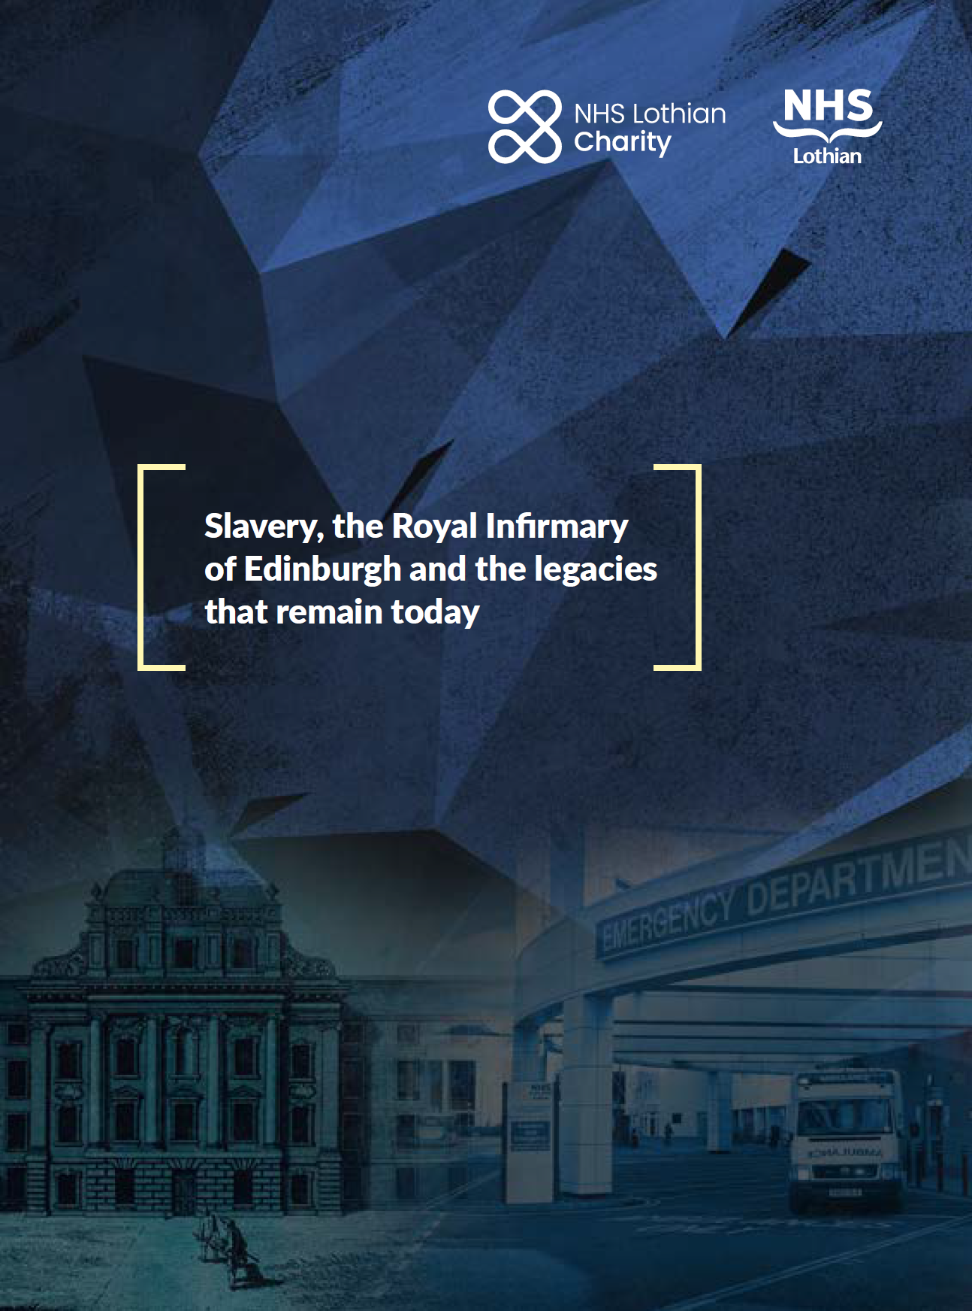
NHS Lothian
Transatlantic Slavery Recommendations
Implementation Group

Slide 2
Contents
Welcome and introduction from Mukhtar Abdullah, Kaylita Chantiluke & Amjad Khan co-chairs of NHS Lothian TASRIG
Background information
Recommendations
Implementation Group
We are recruiting
How to apply

Slide 3
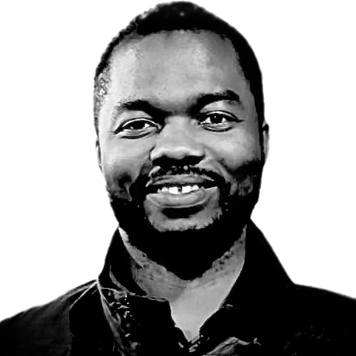
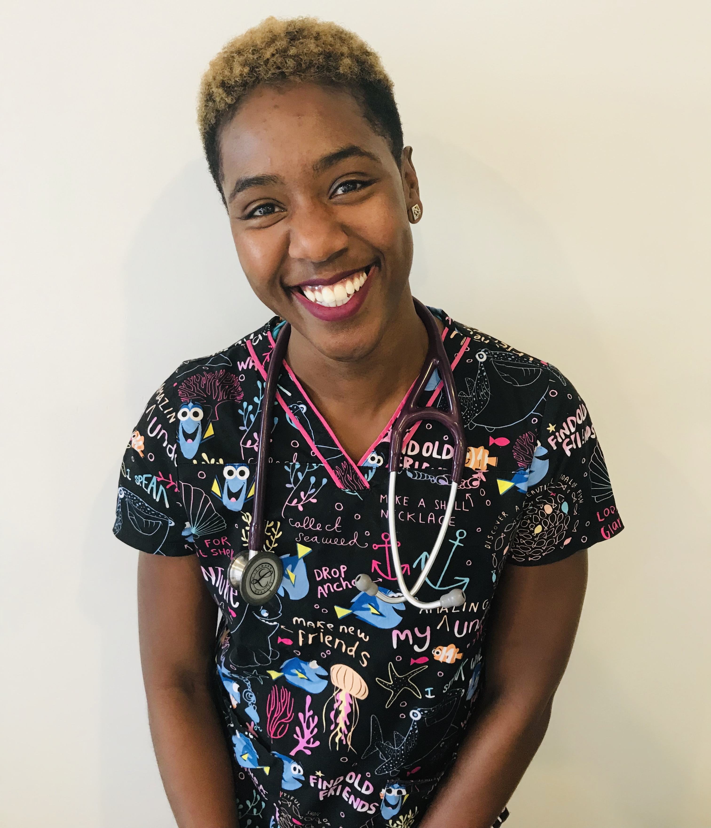
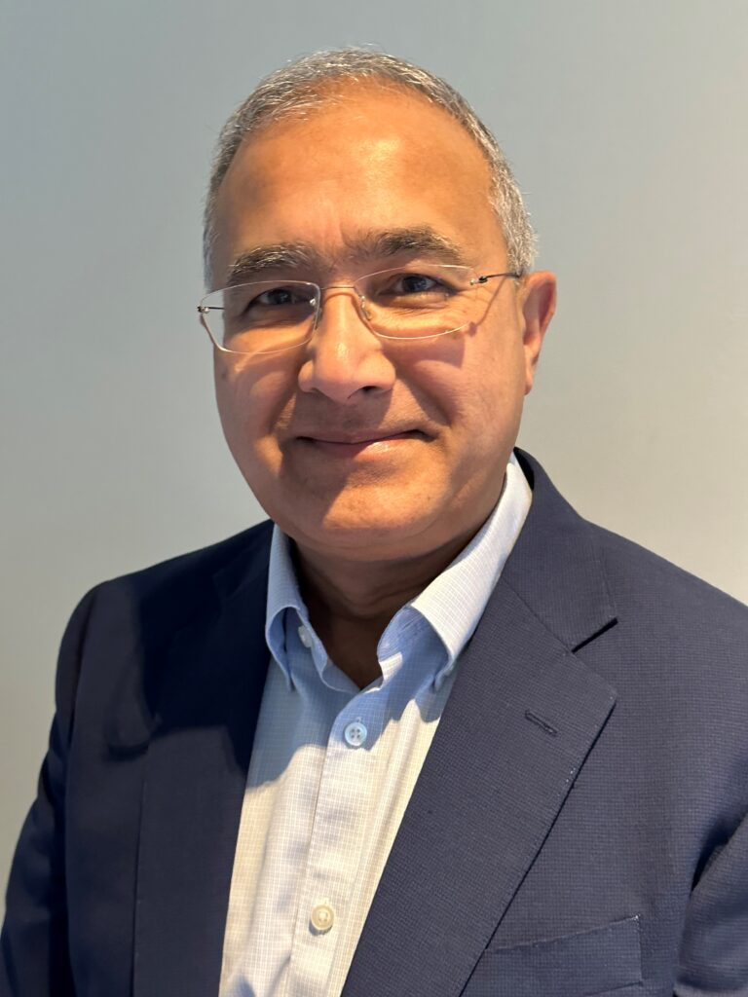
Welcome and introduction
We are excited to invite you to join our mission to tackle the impact of transatlantic chattel slavery in NHS Lothian.
Our work will address the racialised inequalities in NHS Lothian, as well as foster important collaborative bonds with the affected nations.
We are keen to recruit a highly diverse team as we want to draw on the varied wealth of experience that exists in Lothian.
Mukhtar Abdullah
Kaylita Chantiluke
Amjad Khan

Slide 4
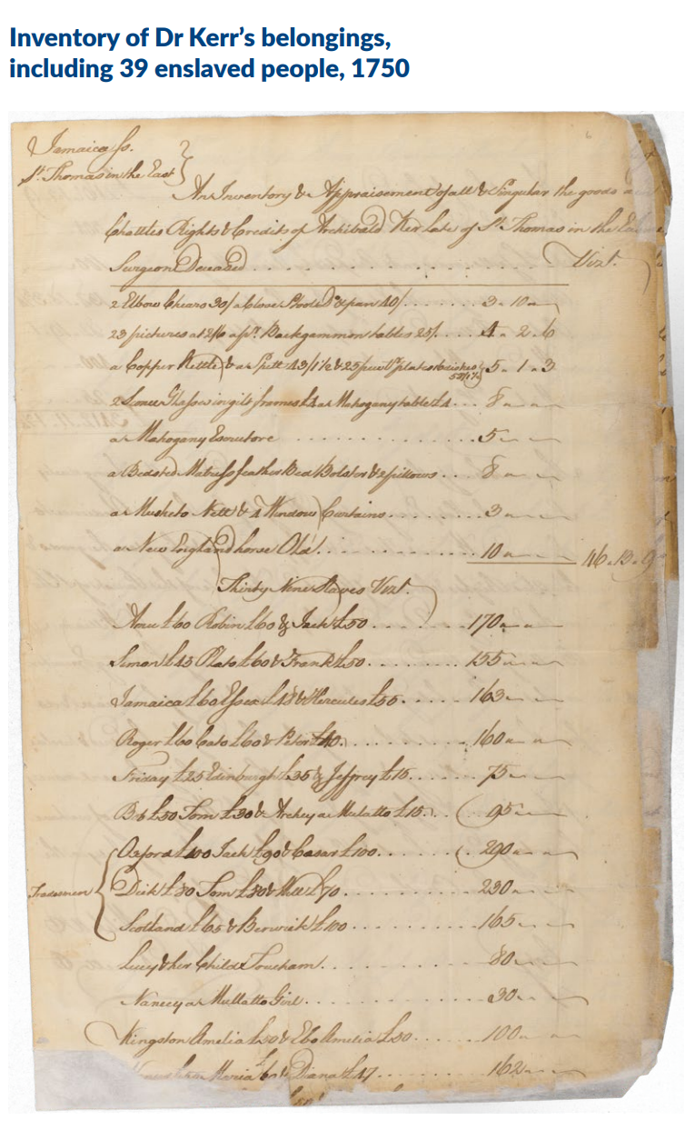
Background information
In 2021 NHS Lothian Charity funded a project to investigate the links the Royal Infirmary of Edinburgh had with transatlantic chattel slavery. It was found that the hospital had received around £39million (approximate modern-day value) from:
Renting out an estate in Jamaica (Red Hill Pen) and the enslaved African people who were held there, for over 143 years.
Donations from people linked to transatlantic slavery.
NHS Lothian believes there is no limitation period when it comes to acknowledging their historical connections to transatlantic slavery. We recognise that every penny of wealth extracted from enslavement is a stain on the Royal Infirmary’s history and we are keen to engage with NHS Lothian’s legal and moral duty to stop racism, inequality and discrimination.

Slide 5
Recommendations
The first step on this journey was the creation of an Independent Advisory Group. Their role was to research connections between the Royal Infirmary of Edinburgh and transatlantic chattel slavery, and suggest an appropriate response. They recommended:
1. Public apology, statement, and official record
2. NHS Lothian Implementation Group and Chair
3. Tackle racialised inequalities in employment and health
4. Commission commemorative works and review current arts and culture activities
5. Education about our history and legacies of transatlantic slavery
6. Partnerships with Jamaica and West African countries
7. Undertake further research
NHS Lothian and NHS Lothian Charity have agreed to implement the recommendations to address the legacy of transatlantic slavery, help remove racism and inequality, and to shape a positive future for everyone.

Slide 6
Implementation Group
The Implementation Group will consist of between 15 - 25 members, including the co-chairs. It will be a diverse group of people who work for or use NHS Lothian services.
It will be responsible for steering and advising on the delivery of the recommendations, for managing relationships with internal and external stakeholders to build momentum for change and for reporting on progress.
It will meet at least six times over a period of two years, with activity required between meetings.
Participation is voluntary and if members are not already being paid while taking part (e.g. in a professional capacity or as a member of NHS Lothian staff) they will receive remuneration following the Scottish Government Guidance: paying participant expenses and compensating for time (2024)
NHS Lothian staff will be given protected time within their contracted hours or Time Off In Lieu (TOIL).

Slide 7
We are recruiting
We are looking for people with the following qualifications, experience and skills:
Diplomacy
Project management
Communication
Policy development
Education
Research and analysis
Equality and anti-racism work
Racialised health and employment inequalities
Decolonialised global health / international development
Learning and research into transatlantic slavery and its legacies
If you think you have something else to offer, please let us know.

Slide 8
How to apply
Interested in joining the Implementation Group? Please email LOTH.equalityandhumanrights@nhs.scot with your full name and email address, and a short message outlining four things:
1. Whether you live or work in Lothian, or both
2. Why you would like to be considered
3. The skills and/or experience you can offer
4. How you would actively contribute to the Group
The deadline is 25 September 2025.
Applicants may then be invited to an informal discussion with the Co-Chairs (date to be agreed).
Appointments will be made through an open application, based on individual merit and the needs of the Group.

Slide 9
Getting in touch
If you have any questions, or would like any of this information in a different format, please contact:
loth.equalityandhumanrights@nhs.scot

